Slide 1

Apple Financial Performance Analysis Report
Developed By : Adarsh Kumar Anil

Slide 2

Company Overview
Apple Inc. is a global leader in technology, specializing in consumer electronics, software, and services.
Key products include the iPhone, Mac, iPad, and Apple Watch, while major services like the App Store, iCloud, and Apple Music drive recurring revenue.
Continuous innovation in hardware, software and ecosystem, makes it one of the most valuable and influential brand in the world.

Slide 3
Objective
The goal of this analysis is to evaluate the Apple’s Financial health by examining the revenue trends, profitability, expenses and stock performance.
This report aims to obtain actionable insights that can inform financial decisions.
Scope of Analysis:
Revenue and Profit over time
Stock Price Performance
Expense Structure & Cost Analysis

Slide 4
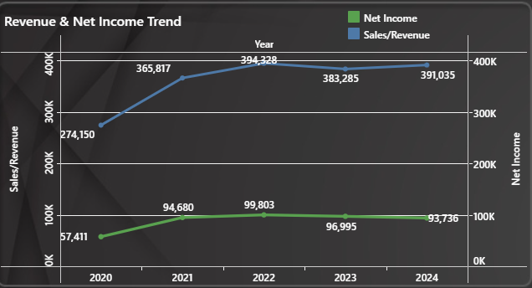
Revenue & Profit Trends
Apple’s revenue has shown consistent growth, with significant increase in 2021 (33.44%) & 2022 (7.79%).
Profit margins remained stable despite fluctuations in operational costs
Global events such as [COVID-19, supply chain disruption and diversion of shipping route in Gulf due to war] has shown some impact on total revenue and net income/profit [in year 2023 & 2024].

Slide 5
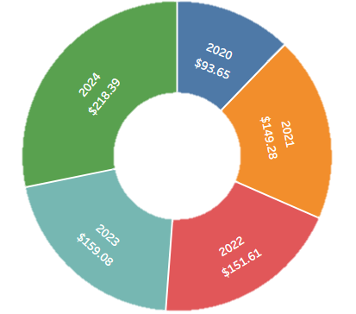
Stock performance
The stock price has experienced significant growth, peaking at [$218.39] in year 2024.
Market events such as [transition from Intel processors to Apple’s own M1, M2 and M3 boosted investors confidence, rising interest rates and supply chain disruptions] led to stock price fluctuations.

Slide 6
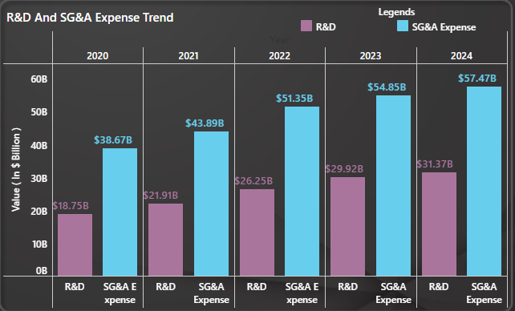
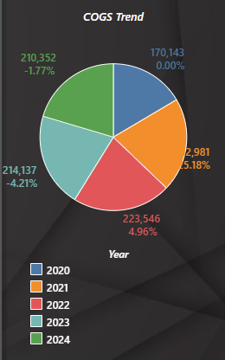
Expense & Cost Analysis
Operating expenses has been increased from $38.67B to $57.47B, mainly driven by R&D expenses.
R&D expenses have seen a high jump from being 48.5% of total SG&A expense to massive 55.59%.
The cost of goods sold (COGS) has had a direct impact on Apple’s net income.

Slide 7
Conclusion
Cost Optimization: Apple should explore supply chain improvements to reduce expenses.
Market Strategy: Expansion into emerging markets could boost revenue growth (Ex: Gemini AI, Robotics, Quantum Computers etc.)
Apple’s revenue growth remains strong despite market fluctuations.
Stock performance aligns with revenue trends but is influenced by external factors.

